Slide 1

HTTPS

Slide 2
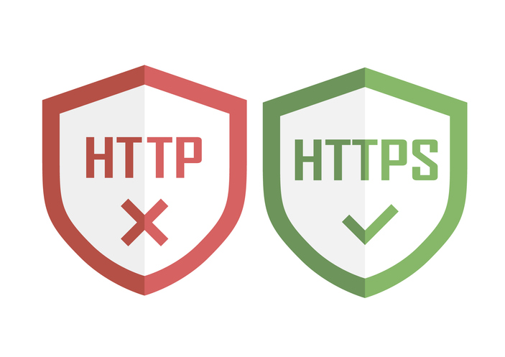
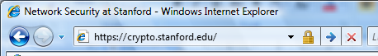
HTTPS and the Lock Icon

Slide 3
Goals for this lecture
Brief overview of HTTPS:
How the SSL/TLS protocol works (very briefly)
How to use HTTPS
Integrating HTTPS into the browser
Lots of user interface problems to watch for

Slide 4
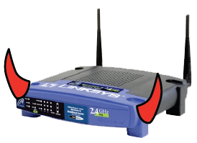
Threat Model: Network Attacker
Network Attacker:
Controls network infrastructure: Routers, DNS
Passive attacker: only eavesdrops on net traffic
Active attacker: eavesdrops, injects, blocks, and modifies packets
Examples:
Wireless network at Internet Café
Internet access at hotels (untrusted ISP)

Slide 5

Certificates
How does Alice (browser) obtain PK_{Bob} ?
Browser Alice
Server Bob
CA
choose
(SK,PK)
PK and
proof “I am Bob”
check
proof
PK_{CA}
PK_{CA}
SK_{CA}
issue Cert with SK_{CA} :
verify
Cert
Bob’s key is PK
Bob’s key is PK
Bob uses Cert for an extended period (e.g. one year)

Slide 6
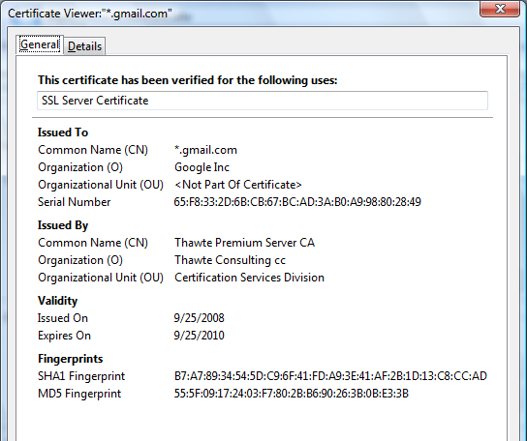
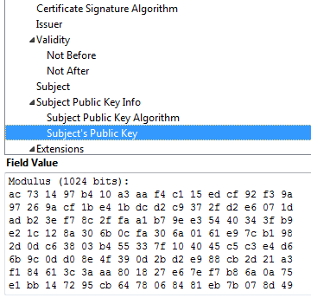
Certificates: example
Important fields:

Slide 7
Certificates on the web
Subject’s CommonName can be:
An explicit name, e.g. cs.stanford.edu , or
A name with a wildcard character, e.g.
*.stanford.edu or cs*.stanford.edu
matching rules:
IE7: “*” must occur in leftmost component, does not match “.”
example: *.a.com matches x.a.com but not y.x.a.com
FF3: “*” matches anything

Slide 8
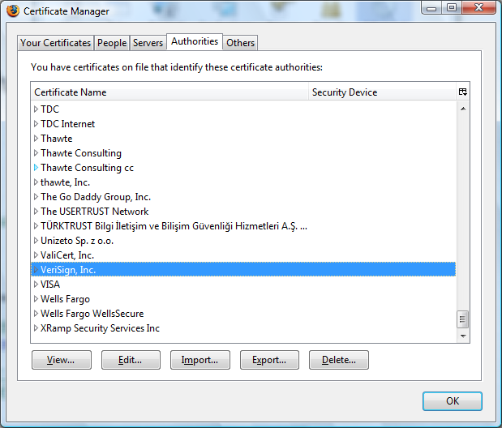
Certificate Authorities
Browsers accept certificates from a large number of CAs

Slide 9
Brief overview of SSL/TLS
browser
server
client-hello
cert
server-hello + server-cert (PK)
SK
key exchange (several options)
rand. k
client-key-exchange: E(PK, k)
k
Finished
HTTP data encrypted with KDF(k)
Most common: server authentication only

Slide 10

Integrating SSL/TLS with HTTP ⇒ HTTPS
Two complications
Web proxies
solution: browser sends
CONNECT domain-name
before client-hello (dropped by proxy)
Virtual hosting:
two sites hosted at same IP address.
solution in TLS 1.1 (RFC 4366)
client_hello_extension: server_name=cnn.com
implemented in FF2 and IE7 (vista)
web proxy
web server
corporate network
web server
client-hello
server-cert ???
cert_{CNN}
cert_{FOX}

Slide 11
Why is HTTPS not used for all web traffic?
Slows down web servers
Breaks Internet caching
ISPs cannot cache HTTPS traffic
Results in increased traffic at web site
Incompatible with virtual hosting (older browsers)

Slide 12
The lock icon: SSL indicator
Intended goal:
Provide user with identity of page origin
Indicate to user that page contents were not viewed or modified by a network attacker
In reality:
Origin ID is not always helpful
example: Stanford HR is hosted at BenefitsCenter.com
Many other problems (next few slides)
Notes:
Network attacker: controls routers, DNS; can inject, delete, and modify packets

Slide 13
When is the (basic) lock icon displayed
All elements on the page fetched using HTTPS
(with some exceptions)
For all elements:
HTTPS cert issued by a CA trusted by browser
HTTPS cert is valid (e.g. not expired)
CommonName in cert matches domain in URL

Slide 14
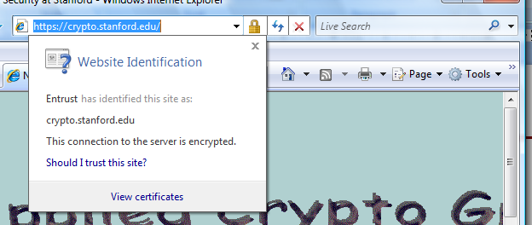
The lock UI: help users authenticate site
IE7:

Slide 15
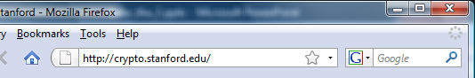
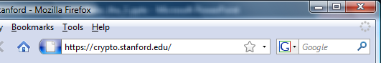
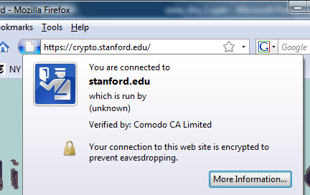
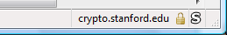
The lock UI: help users authenticate site
Firefox 3:
(no SSL)
(SSL)
Notes:
Click on fav icon gives pop-up on bottom.

Slide 16
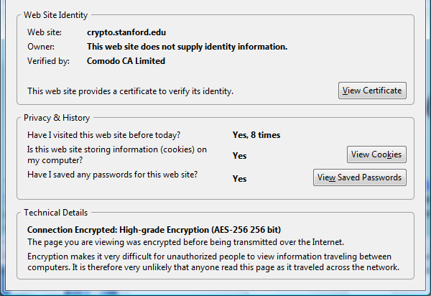
The lock UI: help users authenticate site
Firefox 3: clicking on bottom lock icon gives

Slide 17
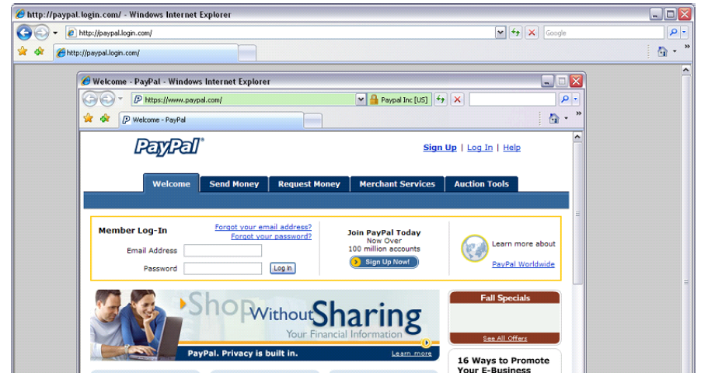
A general UI attack: picture-in-picture
Trained users are more likely to fall victim to this [JSTB’07]
Notes:
Both inner and outer windows are focused

Slide 18
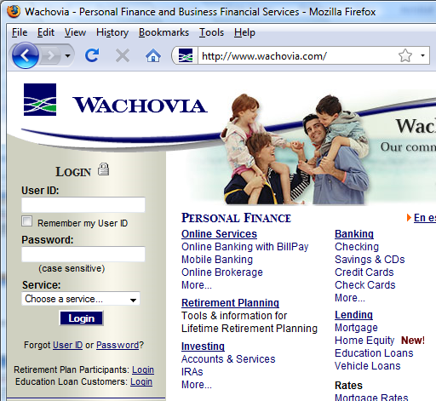
HTTPS and login pages: incorrect version
Users often land on login page over HTTP:
Type site’s HTTP URL into address bar, or
Google links to the HTTP page
View source:
<form method="post"
action="https://onlineservices.wachovia.com/..."
Notes:
User has no way to tell that his password is sent over HTTPS to site. Also has no way to tell that page wasn’t modified enroute (e.g. change form action).
Note the confusing lock next to “LOGIN” that suggests this is HTTPS.

Slide 19
Problems with HTTPS and the Lock Icon
Upgrade from HTTP to HTTPS
Semantic attacks on certs
Invalid certs
Mixed content
HTTP and HTTPS on the same page
Origin contamination
Weak HTTPS page contaminates stronger HTTPS page

Slide 20
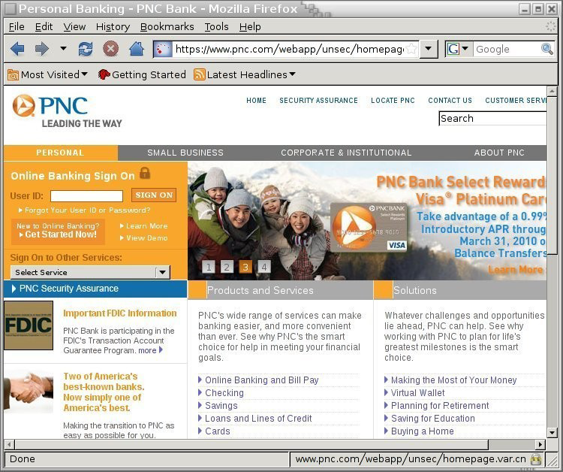
[Moxie’08]

Slide 21
3. Invalid certs
Examples of invalid certificates:
expired: current-date > date-in-cert
CommonName in cert does not match domain in URL
unknown CA (e.g. self signed certs)
Small sites may not want to pay for cert
Users often ignore warning:
Is it a misconfiguration or an attack? User can’t tell.
Accepting invalid cert enables man-in-middle attacks (see http://crypto.stanford.edu/ssl-mitm )

Slide 22
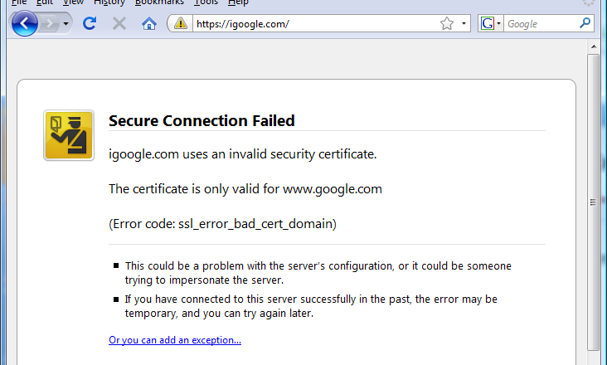
Firefox: Invalid cert dialog
Firefox 3.0: Four clicks to get Firefox to accept cert
page is displayed with full HTTPS indicators

Slide 23
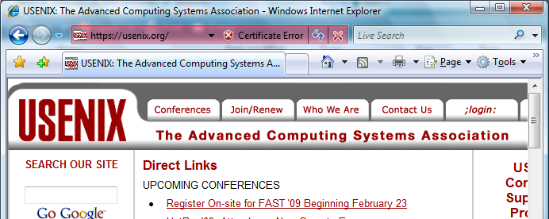
IE: invalid cert URL bar

Slide 24
4. Mixed Content: HTTP and HTTPS
Page loads over HTTPS, but contains content over HTTP
(e.g. <script src=“http://.../script.js> )
IE7: displays mixed-content dialog and no SSL lock
Firefox 3.0: displays `!’ over lock icon (no dialog by default)
Both browsers:
Flash swf file over HTTP does not trigger warning !!
note: Flash can script the embedding page
Safari: does not attempt to detect mixed content

Slide 25
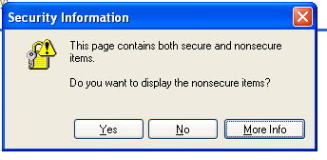
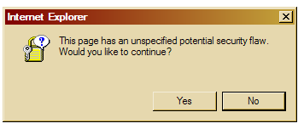
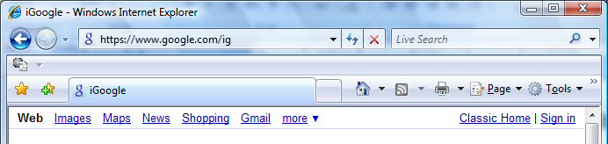
Mixed Content: HTTP and HTTPS
silly dialogs
IE7:
No SSL lock in address bar:

Slide 26
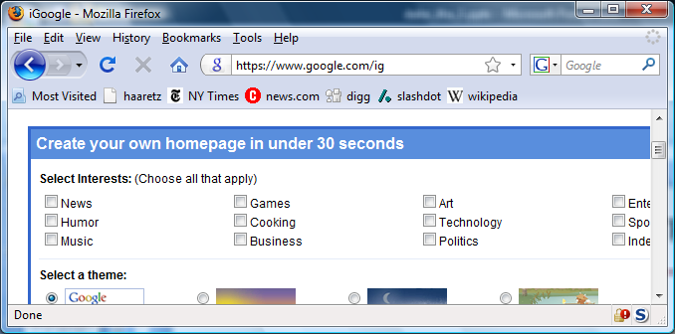
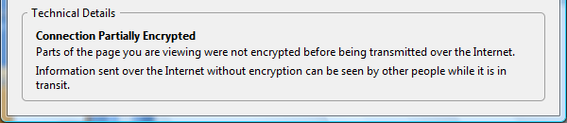
Mixed Content: HTTP and HTTPS
Firefox 3.0:
No SSL indicator in address bar
Clicking on bottom lock gives:

Slide 27
Thank You

